Slide 1
Improving your Test Taking Skills
Ranna Nash, Ph.D.
Director of Academic Support Programs
Assistant Professor of Clinical Education
12/9/2021

Slide 2
Objectives
Describe your learning style in terms of what motivates you and how you learn and study most effectively.​
Apply the question analysis method
Apply techniques to plan your studying around your other commitments.​

Slide 3
VARK Assessments
Visual (V)
Aural/Auditory (A)
Read/write (R)
Kinesthetic (K)
Notes:
https://vark-learn.com/introduction-to-vark/the-vark-modalities/
Visual (V):
This preference includes the depiction of information in maps, spider diagrams, charts, graphs, flow charts, labelled diagrams, and all the symbolic arrows, circles, hierarchies and other devices, that people use to represent what could have been presented in words. This mode could have been called Graphic (G) as that better explains what it covers. It does NOT include still pictures or photographs of reality, movies, videos or PowerPoint. It does include designs, whitespace, patterns, shapes and the different formats that are used to highlight and convey information. When a whiteboard is used to draw a diagram with meaningful symbols for the relationship between different things that will be helpful for those with a Visual preference. It must be more than mere words in boxes that would be helpful to those who have a Read/write preference.
Aural / Auditory (A):
This perceptual mode describes a preference for information that is “heard or spoken.” Learners who have this as their main preference report that they learn best from lectures, group discussion, radio, email, using mobile phones, speaking, web-chat and talking things through. Email is included here because; although it is text and could be included in the Read/write category (below), it is often written in chat-style with abbreviations, colloquial terms, slang and non-formal language. The Aural preference includes talking out loud as well as talking to oneself. Often people with this preference want to sort things out by speaking first, rather than sorting out their ideas and then speaking. They may say again what has already been said, or ask an obvious and previously answered question. They have need to say it themselves and they learn through saying it – their way.
Read/write (R):
This preference is for information displayed as words. Not surprisingly, many teachers and students have a strong preference for this mode. Being able to write well and read widely are attributes sought by employers of graduates. This preference emphasizes text-based input and output – reading and writing in all its forms but especially manuals, reports, essays and assignments. People who prefer this modality are often addicted to PowerPoint, the Internet, lists, diaries, dictionaries, thesauri, quotations and words, words, words… Note that most PowerPoint presentations and the Internet, GOOGLE and Wikipedia are essentially suited to those with this preference as there is seldom an auditory channel or a presentation that uses Visual symbols.
Kinesthetic (K):
By definition, this modality refers to the “perceptual preference related to the use of experience and practice (simulated or real).” Although such an experience may invoke other modalities, the key is that people who prefer this mode are connected to reality, “either through concrete personal experiences, examples, practice or simulation” [See Fleming & Mills, 1992, pp. 140-141]. It includes demonstrations, simulations, videos and movies of “real” things, as well as case studies, practice and applications. The key is the reality or concrete nature of the example. If it can be grasped, held, tasted, or felt it will probably be included. People with this as a strong preference learn from the experience of doing something and they value their own background of experiences and less so, the experiences of others. It is possible to write or speak Kinesthetically if the topic is strongly based in reality. An assignment that requires the details of who will do what and when, is suited to those with this preference, as is a case study or a working example of what is intended or proposed.

Slide 4
Concept Mapping
Notes:
https://www.ttuhsc.edu/medicine/medical-education/success-types/default.aspx
VARK describes the sensory modality that is preferred in taking in information.
You can emphasize that it doesn’t talk about how the information is used. It should be used in organizing.
Question analysis brings attention to how the information should be organized, so there is no conflict in this method and VARK.

Slide 5
Achieving Goals
Higher Course Grades
Carry-over of team study thinking to course study
Analyzing course-relevant Step 1/shelf/2 questions
Strengthen Analytic Thinking
Better time efficiency from long term memory
Reframing thinking process to explain patient data

Slide 6
Weekly Question Analysis Sessions
Based on brain research on learning
Correlated with current course content
Structured protocol; open references
10-12 per team
Some teams may prefer fewer (5-7)
Utilizes side-to-side concept map on whiteboard (template, next slide)
Develops “ruling-out” thinking
Notes:
The strongest learning is not with the preferred learning style but in combining them, e.g. visual and auditory (aural). Kinesthetic can be added to both of those in some cases if the material is organized on a white board.

Slide 7
Patient Data
Discipline Category
Lead-in
Answer Choice 1
History
Answer Choice 2
Answer Choice 3
Physical Exam
Answer Choice 4
Answer Choice 5
Labs
Notes:
This is the descriptive template

Slide 8
Developing your Question Analysis Brain
Notes:
https://mediaweb.neomed.edu/Mediasite/Play/86c3851d67bc4f648b58b67fde1bcdbb1d
https://www.ttuhsc.edu/medicine/medical-education/success-types/non-ttu-esp-step1-prep.aspx
https://www.ttuhsc.edu/medicine/medical-education/success-types/documents/side2sidetemplate.pdf

Slide 9
What Is “Ruling-Out” Thinking?
Rationale for ruling out wrong answers
Saying “why” develops analytic skills
Requires full active learning cycle
Learning cycle explained later
Not guessing, but processing

Slide 10
Let’s do one together
An otherwise healthy 44-year-old man with no prior medical history has had increasing back pain and right hip pain for the past decade. The pain is worse at the end of the day. On physical examination he has bony enlargement of the distal interphalangeal joints. A radiograph of the spine reveals the presence of prominent osteophytes involving the vertebral bodies. There is sclerosis with narrowing of the joint space at the right acetabulum seen on a radiograph of the pelvis. Which of the following diseases is he most likely to have?
A Gout
B Rheumatoid arthritis
C Osteoarthritis
D Osteomyelitis
E Lyme disease
F Pseudogout
Notes:
https://webpath.med.utah.edu/EXAM/MULTORG/bon1frm.htm
(C) CORRECT. Degenerative osteoarthritis is a common and progressive condition that becomes more frequent and symptomatic with aging. There is erosion and loss of articular cartilage with joint space narrowing. There is minimal inflammation.

Slide 11
Let’s do one together: Can You Identify The Appropriate Patient Data?
A 54-year-old female who lives in an economically underdeveloped country is brought to a village clinic in acute cardiac failure. The preferred therapy is intravenous dobutamine, but this drug is too expensive and is therefore unavailable. Which of the following is the most suitable alternative to dobutamine in treating this patient?
Notes:
The important data include the patient’s acute cardiac failure and the preferred therapy. These are added to the map in the next slide.

Slide 12
Here is the Analysis

Slide 13
Now add the Patient Data – add significant information
54-year-old female
acute cardiac failure
intravenous dobutamine
What am I missing?
Notes:
Students now start using their basic science knowledge by stating why each entry is important. For example, the action of dobutamine as a beta agonist.

Slide 14
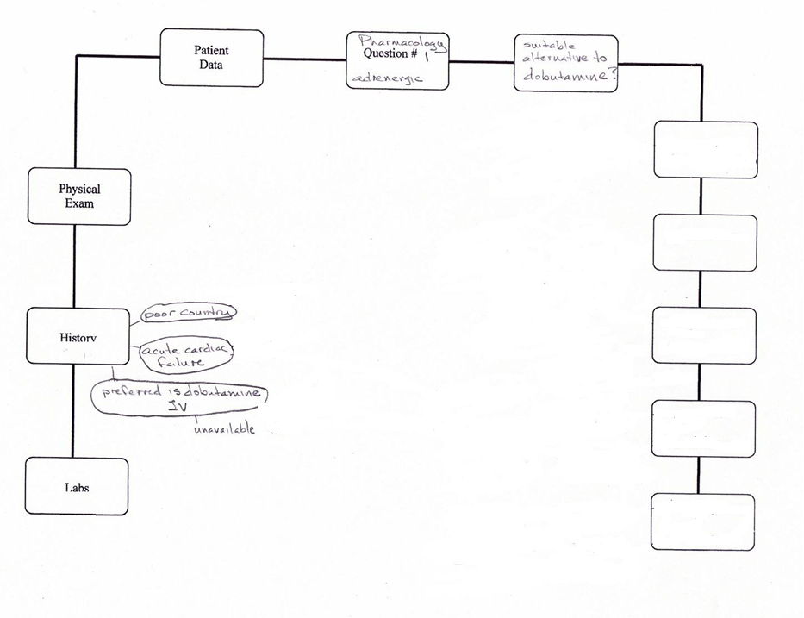
Notes:
In the clinics when working with real patients, there will be more data available, but not all of it will be significant.

Slide 15
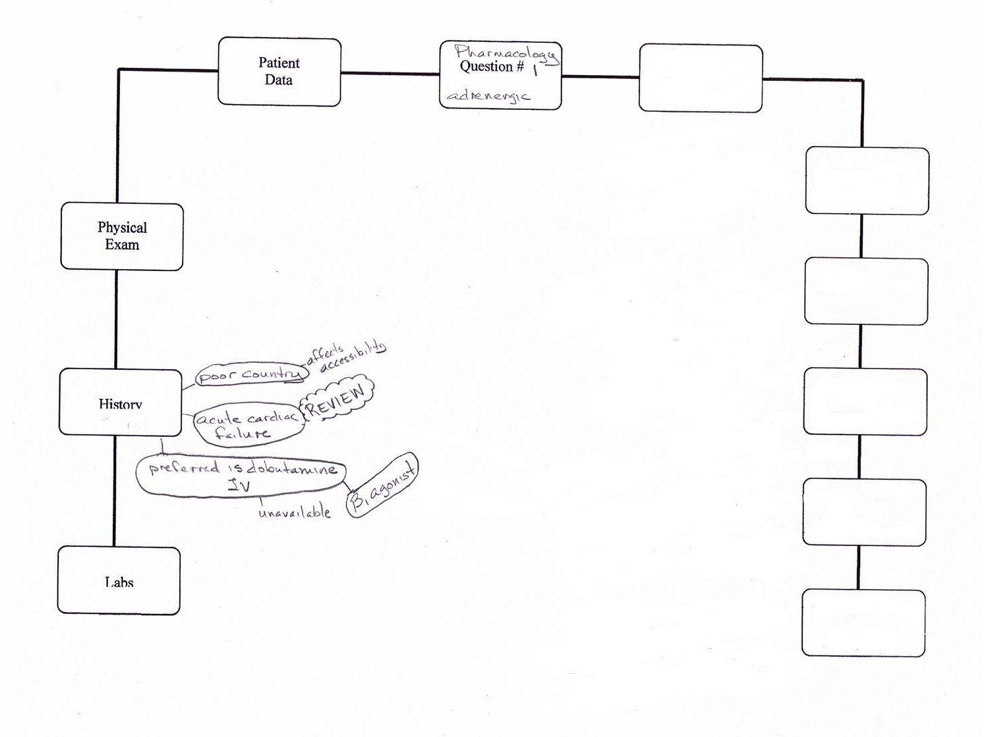
Illustration Of Concept Mapping Process

Slide 16
Now put the answers in: Log in answer choices
Fill in answer choice information in concept map template
Note: The time taken to enter information into map gives “processing” time.
Notes:
Turning attention to the lead-in and the answer choices now allows a focus on what to think about. Students are still processing the information just discussed so this is a good slowing down.

Slide 17
Answer Choices
A 54-year-old female who lives in an economically underdeveloped country is brought to a village clinic in acute cardiac failure. The preferred therapy is intravenous dobutamine, but this drug is too expensive and is unavailable. Which of the following is the most suitable alternative to dobutamine in treating this patient?
A. high dose dopamine
B. ephedrine
C. ephedrine plus propranolol
D. norepinephrine plus phentolamine
E. phenylephrine plus atropine
Notes:
In the clinic, the lead-in will be what are the possible diagnoses? And the answer choices will be the differential diagnosis.

Slide 18
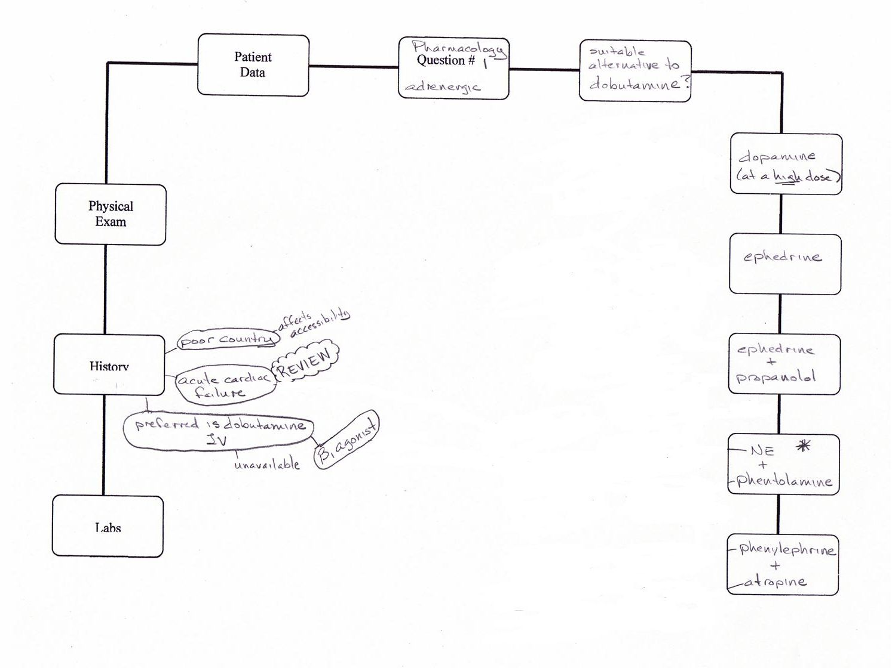
Illustration Of Concept Mapping Process
Notes:
The map is now ready for thinking about the answer choices.

Slide 19
Now decide on facts needed to rule out wrong answers
Identify relevant information for each answer that contributes to ruling it out.
Notes:
There is a big shift in thinking here. It is no longer relevant to simply provide everything you know about each answer. Instead the pre-frontal area is used to make judgments about what is the necessary information that allows us to rule out this choice. Of course, when the correct choice is encountered, the thinking quickly indicates that it cannot be ruled out and must, therefore, be correct.

Slide 20
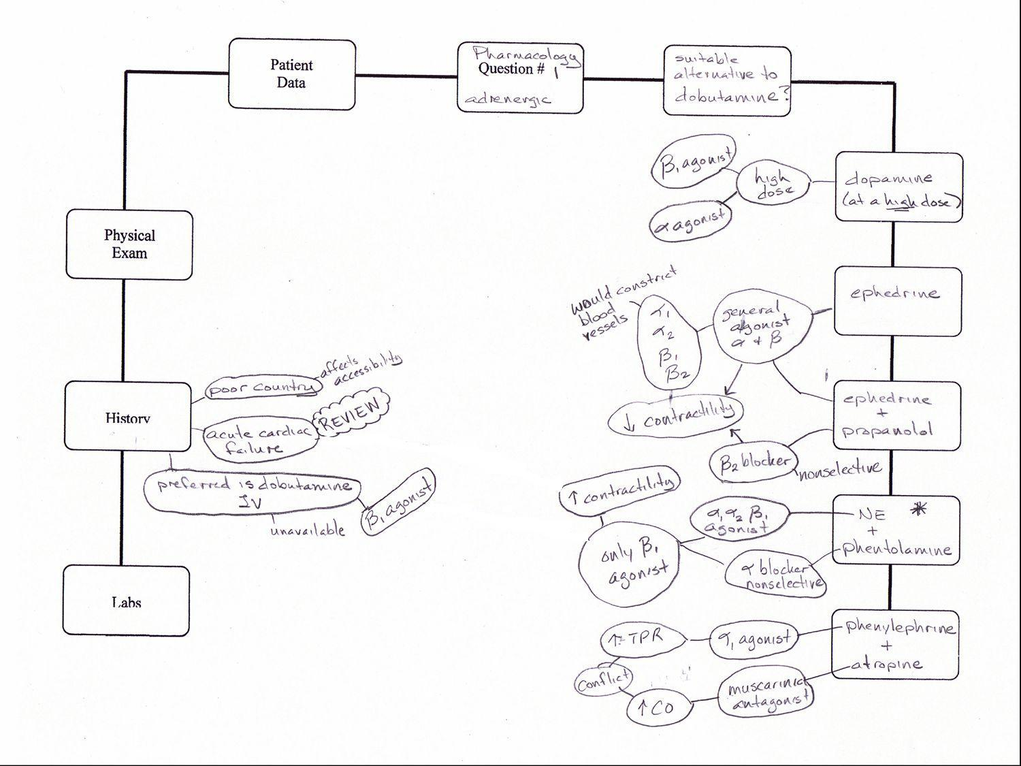
Illustration Of Concept Mapping Process
Notes:
A substantial amount of information is not only visible but discussable. Debates can occur and consensus can be reached. All of which utilize the motor areas of the brain which helps dendrite growth (long term memory) to occur.

Slide 21
Last: Determine correlation cross-links
Propose correlation (pathophysiology) crosslinks between answer choices and patient data in question.
Notes:
At this point, correlations between the answer choices and the symptoms are drawn.

Slide 22
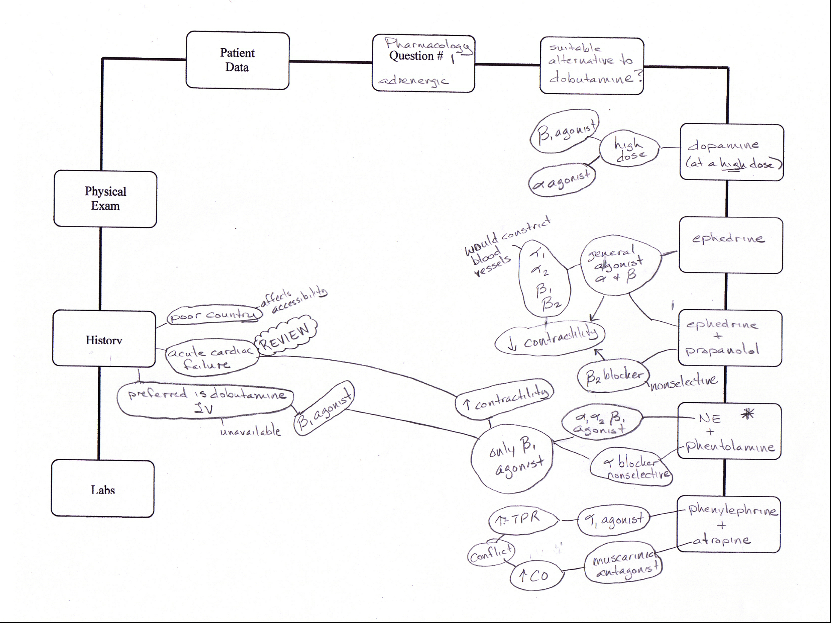
Notes:
The links are pathophysiology and they are the reasoning that underlies not only diagnosis but therapeutic strategy.

Slide 23
What you will be doing in your break rooms: Five Steps
Session leader calls on first student to read lead-in from first question and enters in concept map template.
Session leader continues with first student to read stem from first question and to propose patient data to add to concept map.
Session leader adds additional patient data to concept map by calling on additional students; other “lead-in relevant” information is added to patient data to.
Session leader fills in answer choice information in concept map template
Session leader calls on group members to identify “lead-in relevant” information for each answer that contributes to ruling it out.
Relevance is frequently debated for consensus.
Group proposes pathophysiology crosslinks between answer choices and patient data in question.
Notes:
Each of these steps are considered separately on the slides that follow.

Slide 24
Break out rooms (try together)
Name for group
Speaker for group
Share screen with Map

Slide 25
Break out rooms (try together)
15 minutes to try
An 80-year-old woman has had no major medical problems, but she has never been physically active for most of her life. One day she falls out of bed and immediately notes a sharp pain in her left hip. She is subsequently unable to ambulate without severe pain. Radiographs show not only a fracture of the left femoral head, but also a compressed fracture of T10. Which of the following conditions is she most likely to have?
A Vitamin D deficiency
B Acute osteomyelitis
C Osteogenesis imperfecta
D Osteoporosis
E Polyostotic fibrous dysplasia
F Metastatic breast carcinoma
Notes:
(D) CORRECT. She most likely has osteoporosis of bone with accelerated bone loss leading to the propensity for fractures. Physical inactivity further accelerates bone loss and decreases muscle mass and agility that contribute to falls.

Slide 26
Come together

Slide 27
Break out rooms (try together)
A 51-year-old man has noted constant, dull right hip pain for the past 3 months. On physical examination he has diminished range of motion of the right hip. A radiograph reveals a 10 x 13 cm mass involving the right ischium of the pelvis. The mass has irregular borders and there are extensive areas of bony destruction along with some scattered calcifications. The lesion is resected, and grossly the mass has a bluish-white cut surface. Which of the following is the most likely diagnosis?
A Osteosarcoma
B Enchondroma
C Osteoblastoma
D Chondrosarcoma
E Paget sarcoma
Notes:
(D) CORRECT. Though probably a sporadic occurrence in the case described here, chondrosarcomas can occur in association with enchondromatosis and with osteochondromatosis. Most chondrosarcomas are low grade and have some resemblance to cartilage.

Slide 28
Come together

Slide 29
Break out rooms (try together)
A 62-year-old man has had back pain for 4 months. No abnormal findings are noted on physical examination. Laboratory findings include WBC count of 3700/microliter, hemoglobin 10.3 g/dL, hematocrit 31.1%, MCV 85 fL, and platelet count 110,000/microliter. His total serum protein is 9.5 gm/dl with an albumin of 4.1 gm/dl. A chest radiograph shows no abnormalities of heart or lung fields, but there are several lucencies noted in the vertebral bodies. A sternal bone marrow aspirate is performed and yields a dark red jelly-like material in the syringe. Which of the following cell types is most likely to be numerous on microscopic examination of this aspirate?
A Giant cells
B Fibroblasts
C Osteoblasts
D Metastatic renal carcinoma cells
E Plasma cells
Notes:
(E) CORRECT. The patient has multiple myeloma. The bone marrow needle was in a lytic lesion filled with plasma cells. His serum globulin is high as a result of his monoclonal gammopathy.

Slide 30
Come together

Slide 31
Break out rooms (try together)
A 58-year-old man has the sudden onset of severe pain in his left great toe. There is no history of trauma. On examination there is edema with erythema and pain on movement of the left 1st metatarsophalangeal joint, but there is no overlying skin ulceration. A joint aspirate is performed and on microscopic examination reveals numerous neutrophils and needle-shaped crystals. Over the next 3 weeks, he has two more similar episodes. On physical examination between these attacks, there is minimal loss of joint mobility. Which of the following laboratory test findings is most characteristic for his underlying disease process?
A Hyperglycemia
B Positive antinuclear antibody
C Hyperuricemia
D Hypercalcemia
E High rheumatoid factor titer
Notes:
(C) CORRECT. Gouty arthritis can be associated with hyperuricemia, but not all cases of gout have hyperuricemia. The big toe is the most common joint involved with gout, caused by monosodium urate crystal deposition. These crystals are needle-shaped with negative birefringence under polarized light microscopy and 'red plate' retardation. Acute gouty attacks are associated with intense pain from acute inflammation.

Slide 32
Come together

Slide 33
Time Management
1) Ask for help: If you find you are overwhelmed, maxed-out for time to complete a task, ask for assistance from a friend, relative, or, someone who is equipped to assist with your task.​
2) Exercise and sleep: I tend to get a rush of thoughts that surface to my mind after a good workout. Studies have shown that exercise not only helps to beat stress and enlighten your mood but it also sharpens your intellect which allows you to function better and therefore, be more productive. By following the recommended hours of sleep, which are between seven and eight hours, your body is better able to function properly.​
3) Social-media boundaries: In today’s world of constant information sharing via television and social media, we must learn to set boundaries around consuming the influx of constant digital information. I find that setting household rules on social media around mealtime allows our family the one-on-one time we all deserve. Just because social media is on 24/7 doesn’t mean you need to be if it is disruptive to your schedule.​
4) Take notes: Whether you write your tasks down on a note pad, or on your smartphone’s note pad, it is helpful to capture a list of tasks that need to be completed. I find that by creating lists and notes on my smartphone I am better able to keep track of my tasks.​
5) Calendar: Paper calendars are great, but, let’s face it, they can get lost and they are tricky to share. I have found a digital calendar to be extremely useful. I share it with my husband so he knows where I am and what I am doing and vice versa. Everything is entered on my calendar from my daily run to the exact time and location of family activities.​

Slide 34
This CAN be fun
Notes:
Final words

Slide 35
References
https://www.ttuhsc.edu/medicine/medical-education/success-types/​
https://www.myersbriggs.org/my-mbti-personality-type/mbti-basics/the-16-mbti-types.htmttp://www.4mat.eu/4mat-what-is-it.aspx​
http://lotrminecraftmod.wikia.com/wiki/File:Harry_Potter_MBTI.jpg​
​https://vark-learn.com

Slide 36
Please do not be afraid to contact me
rannanas@usc.edu

